Slide 1
JOURNEY PPT
ANSUMAN NAYAK
ANSUMAN NAYAK
655475
INANJJ

Slide 2
WEEK 4 - AGENDA(GENERIC IDA)
Day 1 - Azure Synapse Analytics
Day 2 - Data Viz using Power BI 1
Day 3 - Data Viz using Power BI 2
Day 4 - Python Day-1

Slide 3
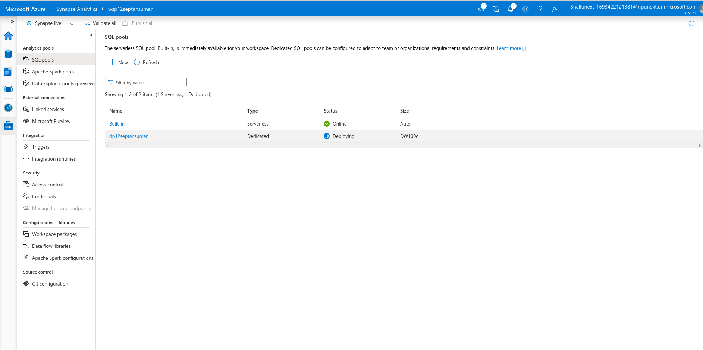
DAY – 1 (AZURE SYNAPSE ANALYTICS)
Introduction to SQL Pool
Key Features of SQL Pool
Azure synapse mapping data pool
Data Ingestion and Preparation
Using Azure synapse to Ingest data from various sources into SQL Pool.
Exploring the SQL Pool and analyzing.

Slide 4
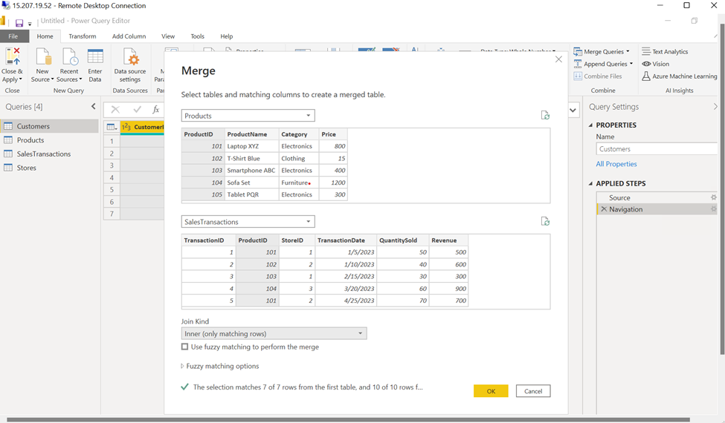
DAY – 2 (DATA VIZ USING POWER BI 1)
Understanding Power BI
Connecting Power BI to SQL Managment server
Importing data from CSV, Excel, SQL server, etc
Importing data by Web Scrapping using Power BI
Data Transformation - Slicing, replacing, splitting, handling duplicates.
Introduction to DAX and Calculated columns’

Slide 5
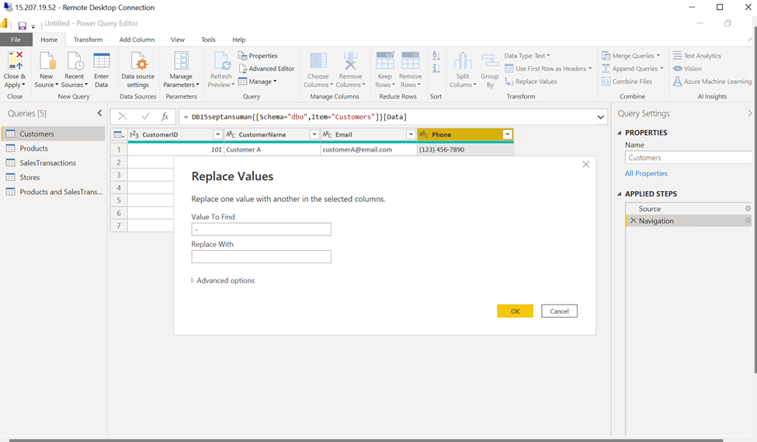
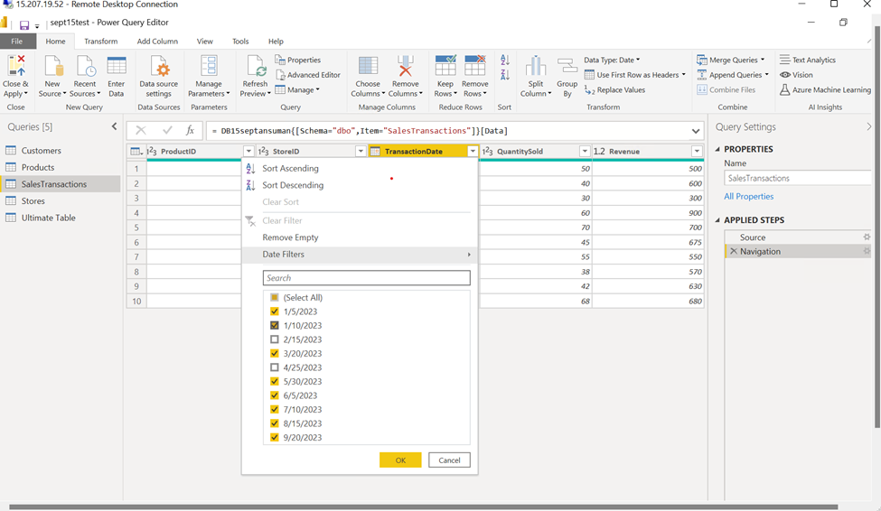
DAY – 2 (DATA VIZ USING POWER BI 1)

Slide 6
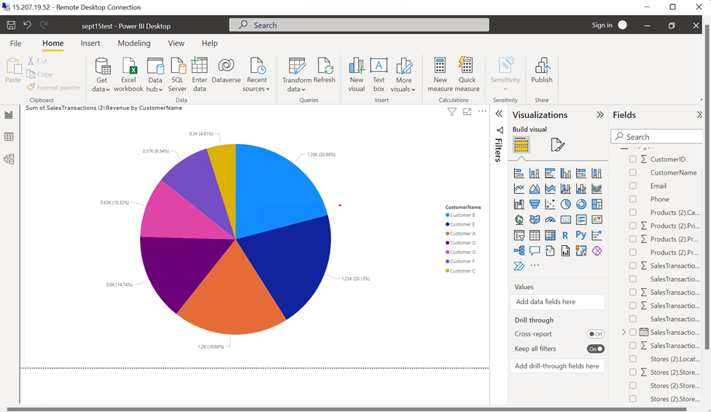
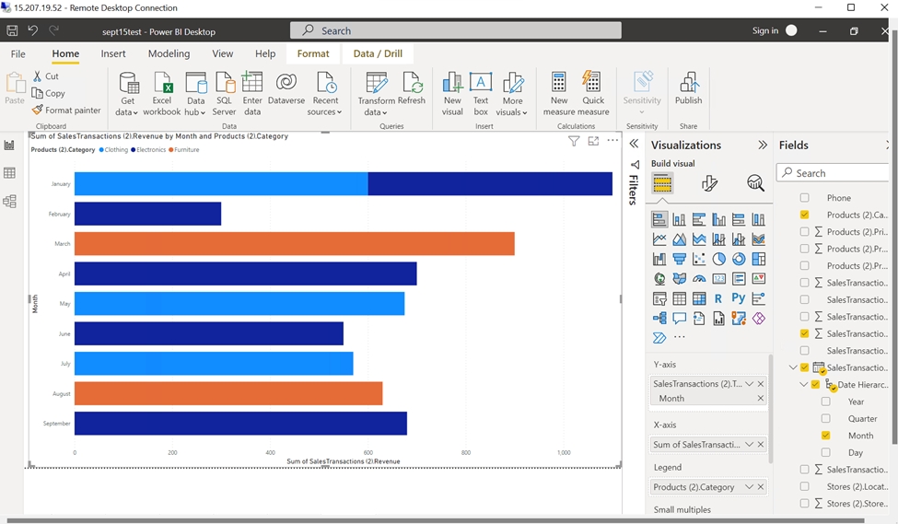
DAY – 3 (DATA VIZ USING POWER BI 2)

Slide 7
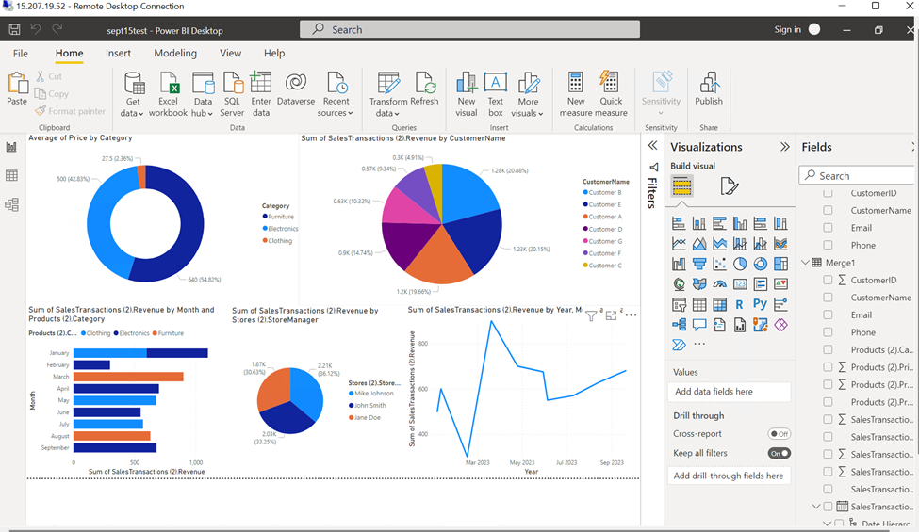
DAY – 3 (DATA VIZ USING POWER BI 2)

Slide 8
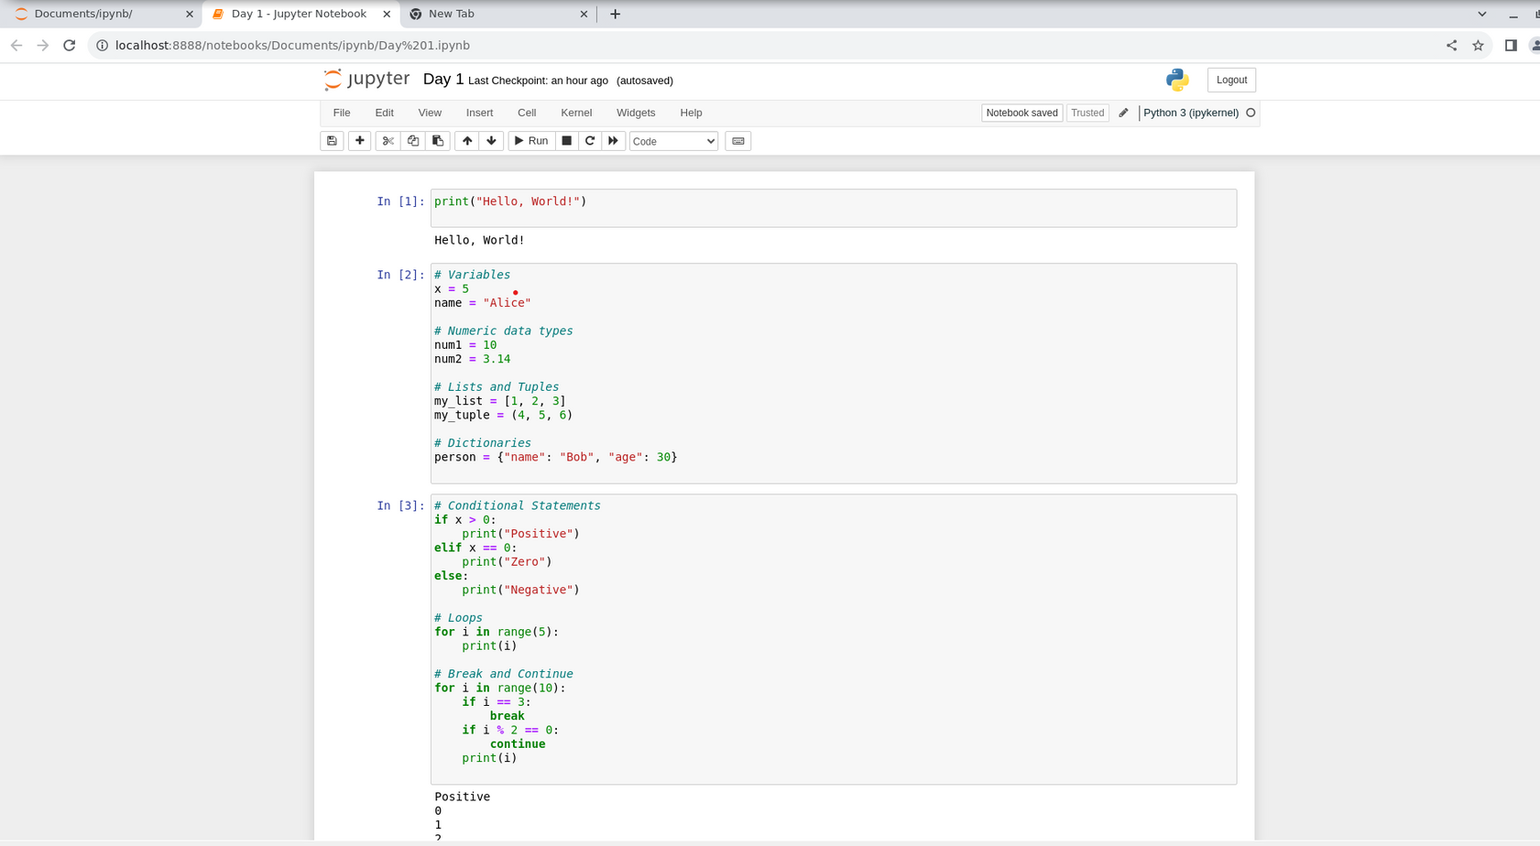
DAY – 4 (PYTHON DAY-1)
Understanding Power BI
Connecting Power BI to SQL Managment server
Importing data from CSV, Excel, SQL server, etc
Importing data by Web Scrapping using Power BI
Data Transformation - Slicing, replacing, splitting, handling duplicates.
Introduction to DAX and Calculated columns’

Slide 9
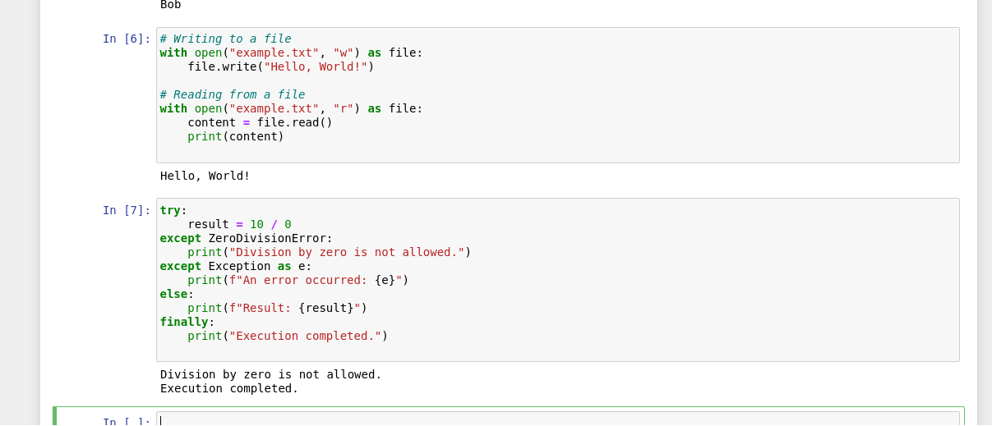
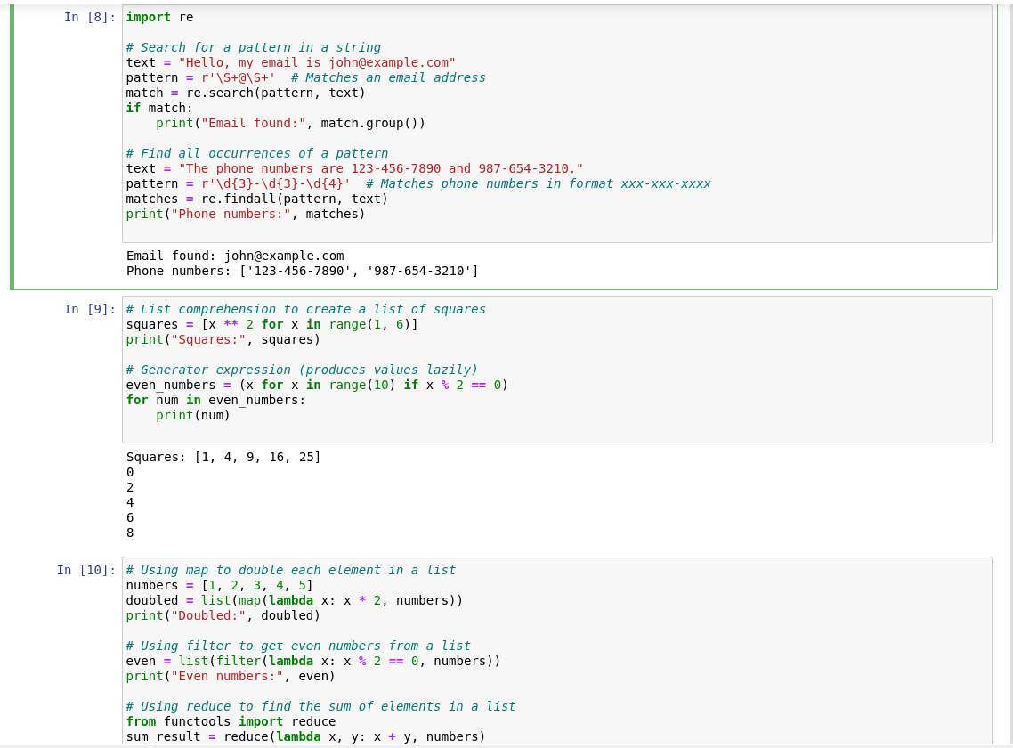
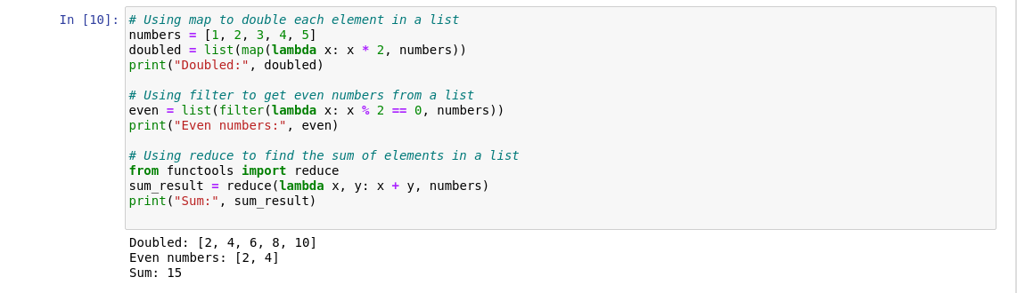
DAY – 4 (PYTHON DAY-1)

Slide 10
Thank you!

